Slide 1
Array And Functions

Slide 2
Array
Java array is an object which contains elements of a similar data type. Additionally, The elements of an array are stored in a contiguous memory location. It is a data structure where we store similar elements. We can store only a fixed set of elements in a Java array.
In Java, all arrays are dynamically allocated
Arrays are stored in contiguous memory [consecutive memory locations].
Since arrays are objects in Java, we can find their length using the object property length. This is different from C/C++, where we find length using sizeof.
A Java array variable can also be declared like other variables with [] after the data type.

Slide 3
An array can contain primitives (int, char, etc.) and object (or non-primitive) references of a class depending on the definition of the array.
In the case of primitive data types, the actual values are stored in contiguous memory locations.
In the case of class objects, the actual objects are stored in a heap segment.

Slide 4
int a[]=new int[5];//declaration and instantiation
a[0]=10;//initialization
a[1]=20;
a[2]=70;
a[3]=40;
a[4]=50;
//traversing array
for(int i=0;i<a.length;i++)//length is the property of array
System.out.println(a[i]);
}}

Slide 5
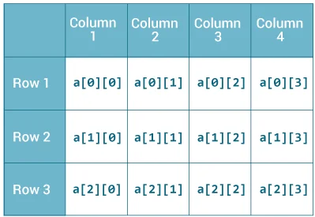
Java Multidimensional Arrays
A multidimensional array is an array of arrays. Each element of a multidimensional array is an array itself. For example,
int[][] a = new int[3][4];
Here, we have created a multidimensional array named a. It is a 2-dimensional array, that can hold a maximum of 12 elements,

Slide 6
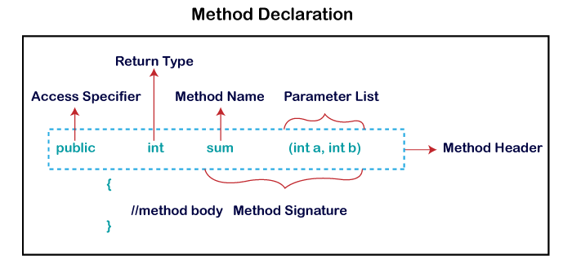
Methods In Java
A method is a block of code which only runs when it is called.
You can pass data, known as parameters, into a method.
Methods are used to perform certain actions, and they are also known as functions.

Slide 7
Method Overloading in Java
multiple methods having same name but different in parameters, it is known as Method Overloading.
Different Ways of Method Overloading in Java
Changing the Number of Parameters.
Changing Data Types of the Arguments.
Changing the Order of the Parameters of Methods

Slide 8
Varargs
In Java, varargs (variable-length arguments) is a feature that allows a method to accept a variable number of arguments of the same type.
Varargs are useful when you want to create methods that can take a different number of arguments without having to specify them individually.
Varargs are represented by an ellipsis (...) followed by the argument type.

